Slide 1



ANALYZING DATA

Slide 2

AGENDA
What is Data Analysis?
Aggregate Functions in SQL
HAVING Operator
Examples

Slide 3
What is Data Analysis?

Slide 4



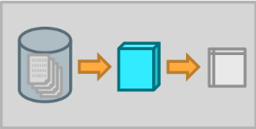
WHAT IS DATA ANALYSIS?
After collecting, cleaning and transforming the data, we can start analyzing it to answer out questions
Data Question / Problem
Cleaning and Transforming
Data Analysis
Insights

Slide 5
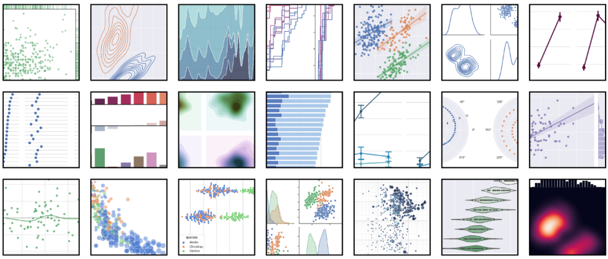
WHAT IS DATA ANALYSIS?
Visualization of data is often the first step of Data Analysis (EDA)

Slide 6
WHAT IS DATA ANALYSIS?
Data analysis is performed using different operations and techniques:
• (Additional) data transformation (e.g., aggregation, filtering, etc.)
• Trend analysis
• Histograms / distributions
• Models / relationships
• Clustering
• Predictions
SQL
Python

Slide 7
WHAT IS DATA ANALYSIS?
Data analysis is performed using different operations and techniques:
• (Additional) data transformation (e.g., aggregation, filtering, etc.)
• Trend analysis
• Histograms / distributions
• Models / relationships
• Clustering
• Predictions
SQL
Python
WHERE
GROUP BY
HAVING

Slide 8
Aggregate Functions and HAVING in SQL

Slide 9
AGGREGATE FUNCTIONS IN SQL
By now we should be familiar with most of these functions:
COUNT(): Number of rows (overall or in a column)
MIN(): Minimum value
MAX(): Maximum value
SUM(): Sum of values
AVG(): Average of values
STDDEV(): Standard deviation of values
PostgreSQL: Documentation: 9.1: Aggregate Functions

Slide 10
HAVING OPERATOR
HAVING can be used to filter and manipulate aggregated data
Usually used in conjunction with GROUP BY to apply conditions after the grouping
Evaluated after the GROUP BY clause
Filters based on aggregate functions rather than individual rows (WHERE operator does that)
Allows us to apply conditions to summarized data and perform calculations and analysis on groups of data

Slide 11
HAVING OPERATOR
SELECT productname,
AVG(unitprice) AS avg_price
FROM products
GROUP BY productname
HAVING AVG(unitprice) > 50

Slide 12
Practice Time! (but break first)
Notes:
Timer works with extension “Slides Timer”

Slide 13
EXERCISES
Show positions with more than 1 employee and the number of employees
Find employees who have handled more than 100 orders, along with the total number of countries they handled orders from
Show customers who have placed at least 10 orders and have an average discount more than 5%
Show products with a total quantity ordered greater than 500 in categories having at least 10 products. Include all products in category count
Find products with 3 highest total sales amount and 3 lowest total sales amount, excluding products with fewer than 10 orders

